Slide 1

01
02
C Language
Lecture 19
04

Slide 2


Today’s Agenda
01
Nested if
02
Some Example of Nested if

Slide 3
Nested if
A nested if in C is an if statement that is the target of another
if statement.
Nested if statements means an if statement inside another if statement.
Both C and C++ allows us to nested if statements within if statements,
i.e., we can place an if statement inside another if statement.

Slide 4
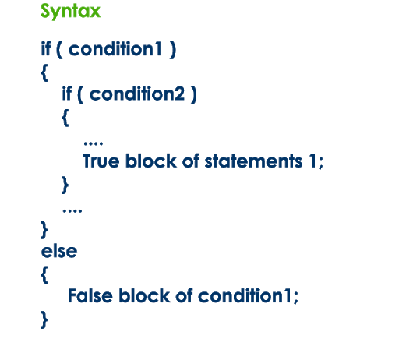
Syntax of Nested if

Slide 5
Nested if
For Example :
if(test_condition 1 && test_condition 2)
{
statement;
}
Can you write the above code without using any LOGICAL OPERATOR ?

Slide 6
Nested if
Yes, Using nested if
if(test_condition1)
{
if(test_condition2)
{
statement;
}
}

Slide 7
Exercise
WAP to accept 3 unique integer from the user and
find out the greatest number amongst them.
Make sure your code does not use any LOGICAL
OPERATOR.

Slide 8
Solution
void main()
{
int a,b,c;
clrscr();
printf(“Enter 3 unique integers:”);
scanf(“%d %d %d”,&a,&b,&c);
if(a>b)
{
if(a>c)
printf(“%d is greater”,a);
else
printf(“%d is greater”,c);
}
else
{
if(b>c)
printf(“%d is is greater”,b);
else
printf(“%d is greater”,c);
}
getch();
}

Slide 9

Solution
Is this code correct ?
if(a>b)
{
if(a>c)
printf(“%d is greater”,a);
}
else
{
if(b>c)
printf(“%d is is greater”,b);
else
printf(“%d is greater”,c);
}
Compile ?
Run ?
Output ?
Sometime Correct
Sometime Wrong

Slide 10
Exercise
Admission to a profession course is given according to the
following criteria:
Marks in Physics >= 50 AND Marks in Chemistry >= 55
AND Marks in Math's >=60
Total in all three subjects >= 220 OR total in Math’s and
Physics >= 130

Slide 11
Exercise
WAP to accept marks in P,C,M from the user and find out whether the user is eligible for admission or not.
Make sure your code doesn't use any LOGICAL OPERATOR

Slide 12
Exercise
For Example :
Case 1 :
Physics = 50
Chemistry = 50
Math’s = 60
Will he get admission ?
No
Case 2 :
Physics = 100
Chemistry = 0
Math’s = 100
Will he get admission ?
No

Slide 13
Solution
if(p+c+m>=220)
printf(“Admission given);
else if(p+m>=130)
printf(“Admission given”);
else
printf(“Admission not given);
}
else
printf(“Admission not given”);
}
else
printf(“Admission not give”);
}
else
printf(“Admission not given”);
getch():
}
void main()
{
int p,c,m;
clrscr();
printf(“Enter marks of p,c,m:”);
scanf(“%d %d %d”,&p,&c,&m);
if(p>=50)
{
if(c>=55)
{
if(m>=60)
{

Slide 14
Exercise
Question 1.
Redesign the previous code using LOGICAL OPERATOR.
Question 2.
An insurance company provides insurance to its
employees according to the following criteria :

Slide 15
Exercise
1. If the employee is married
2. If the employee is unmarried, male and above 35 years of age.
3. If the employee is unmarried, female and above 30 years of age.
In all other cases, insurance is not give.
WAP to accept age, gender and marital status from the user and check
whether he/she is eligible for insurance or not.
DO NOT USE ANY LOGICAL OPERATOR

Slide 16

End of Lecture 19
For any queries mail us @: scalive4u@gmail.com
Call us @ : 0755-4271659, 7879165533
Thank you

